Slide 1
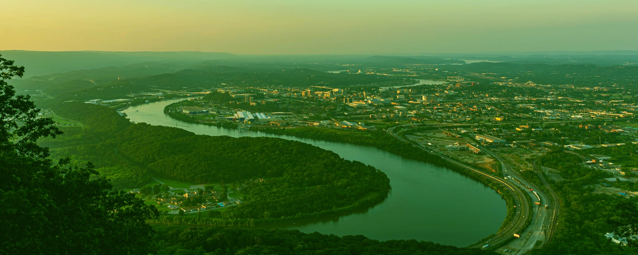
Species Diversity in Tennessee Counties and Watersheds
Examining biodiversity in watershed geographies in the State of Tennessee.
Notes:
Hello and thank you for coming to hear me speak on species diversity in Tennessee counties and watersheds. I wanted to use this analysis to examine biodiversity in the state as a whole.

Slide 2
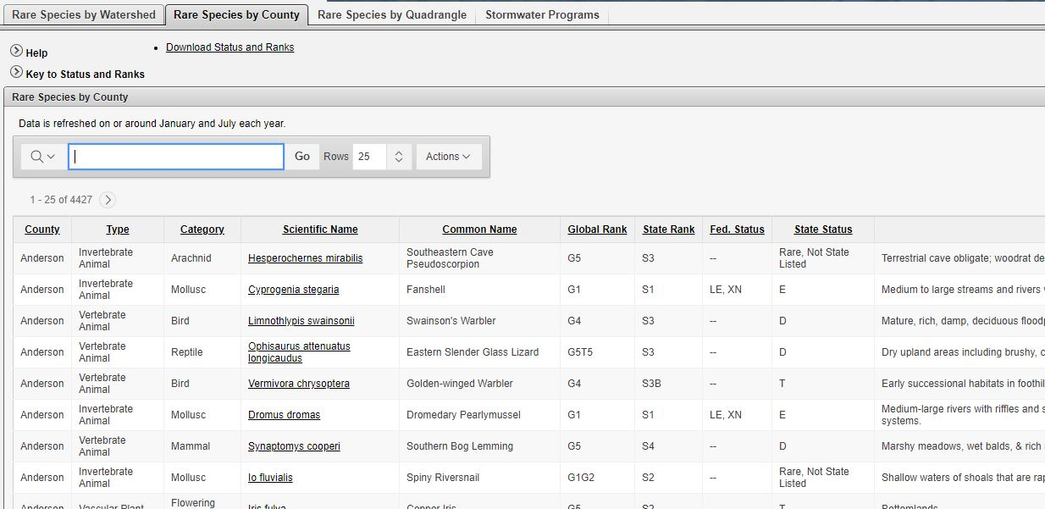
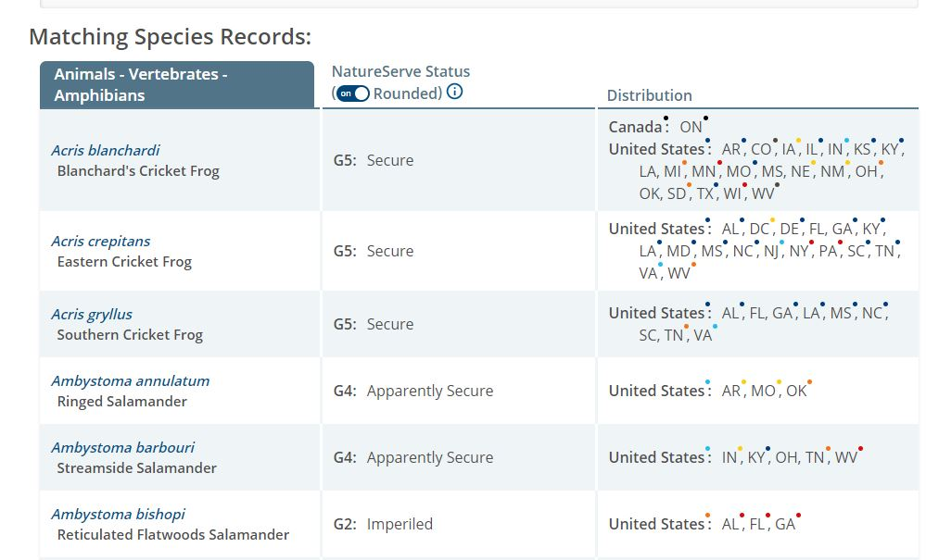


Natural Heritage Data
Rare species data viewer: Tennessee Department of Environment and Conservation
The Larger natural heritage data community
Notes:
I gathered data from the Tennessee Department of Environment and Conservation’s Rare Species Data Viewer. This is part of the Natural Heritage Inventory program which maintains a GIS database containing information on the distribution and ecology of rare plants, animals, and ecological communities across Tennessee. This data is managed by TDEC but any citizen can contribute species sightings to this dataset.
The project is a part of a larger inventory project maintained by nonprofit NatureServe, which has multiple member organizations that contribute to its larger dataset. This ensures that the methodology is consistent and scientists and other audiences can be assured of a certain quality standard. The gathering methodology has evolved with time but has basic continuity over the last 40 years. This particular state dataset is a compilation of observations from the past 40 years.

Slide 3
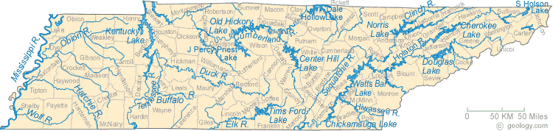
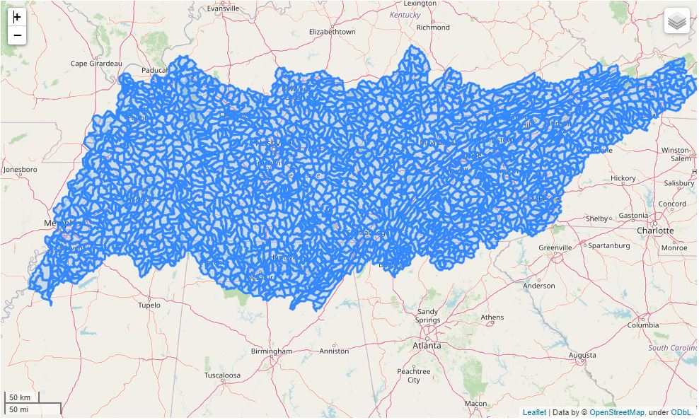
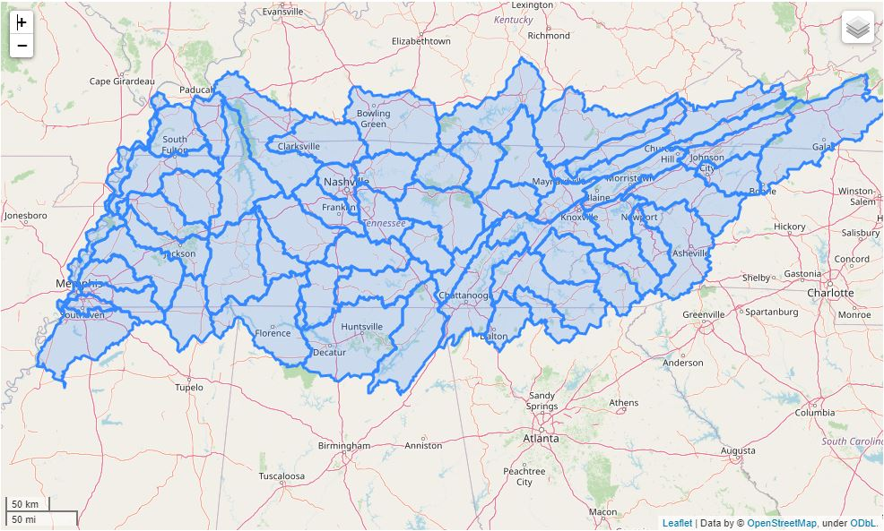
Watersheds
Notes:
Before jumping in I wanted to give a little rundown on the natural geographies used here - a watershed is a land area that channels rainfall and snowmelt to creeks, streams, and rivers, and eventually to outflow points like reservoirs, bays, and the ocean. They’re defined on several scales – referred to as hydraulic unit codes, or HUCs. On the top I’ve included a map of major Tennessee rivers and streams, and on the bottom left I’ve provided a map showing the state split into 12 digit HUCs, finally the map on the right shows the state split into 8 digit HUCs. For this project I used 8 digit geographies.

Slide 4
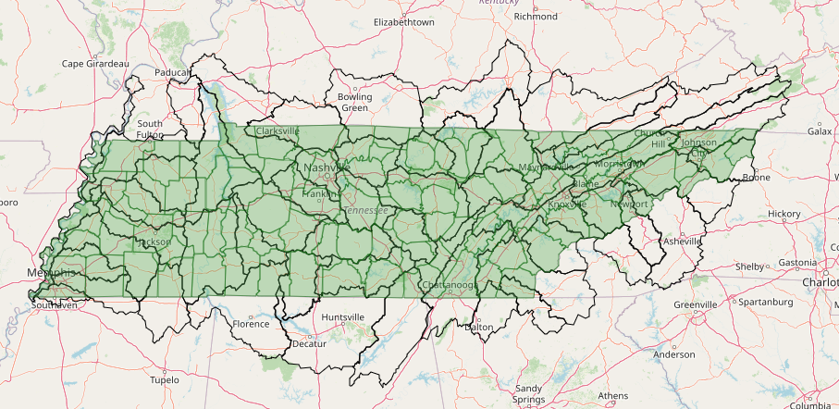
Watersheds and Counties
County Overlay and Watersheds overlay
Notes:
Just for reference, as we all probably know where county boundaries are a bit better than watersheds, I’ve provided a quick visual overlay as well as a couple of interactive tools. A spoiler is that we’re going to see a lot of biodiversity and rare species observations occurring in the Caney Fork River Watershed North of Chattanooga and East of Nashville (show on ws_top), and if we look at what Counties lie in here we see that it almost completely contains DeKalb, White, and Van Buren, and it intersects with Wilson, Cannon, Smith, Putnam, Cumberland, Bledsoe, and Warren Counties.

Slide 5
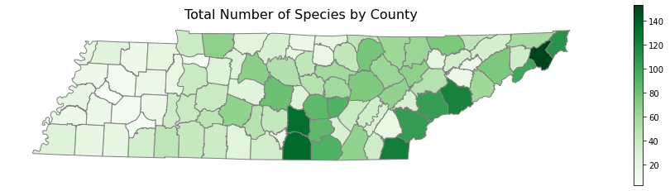
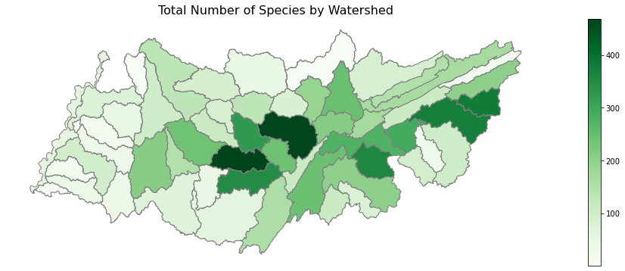
Total Species Counts
Notes:
Interestingly, when you group total species observations different ways the counties break out such that we’re seeing the most total observations in Carter County, in the northeast part of the State. However when you look at watersheds you are seeing the highest species counts in The Caney Fork River as well as the Upper Duck River watersheds.
What you’re looking at here is a breakout of 115,612 species observations representing 928 unique species.

Slide 6
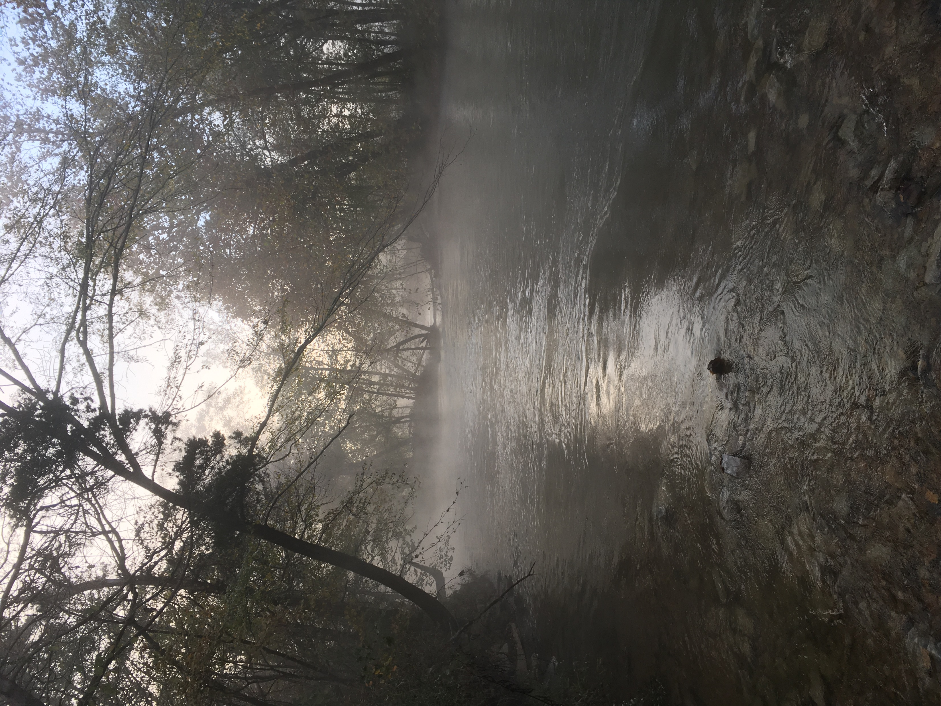
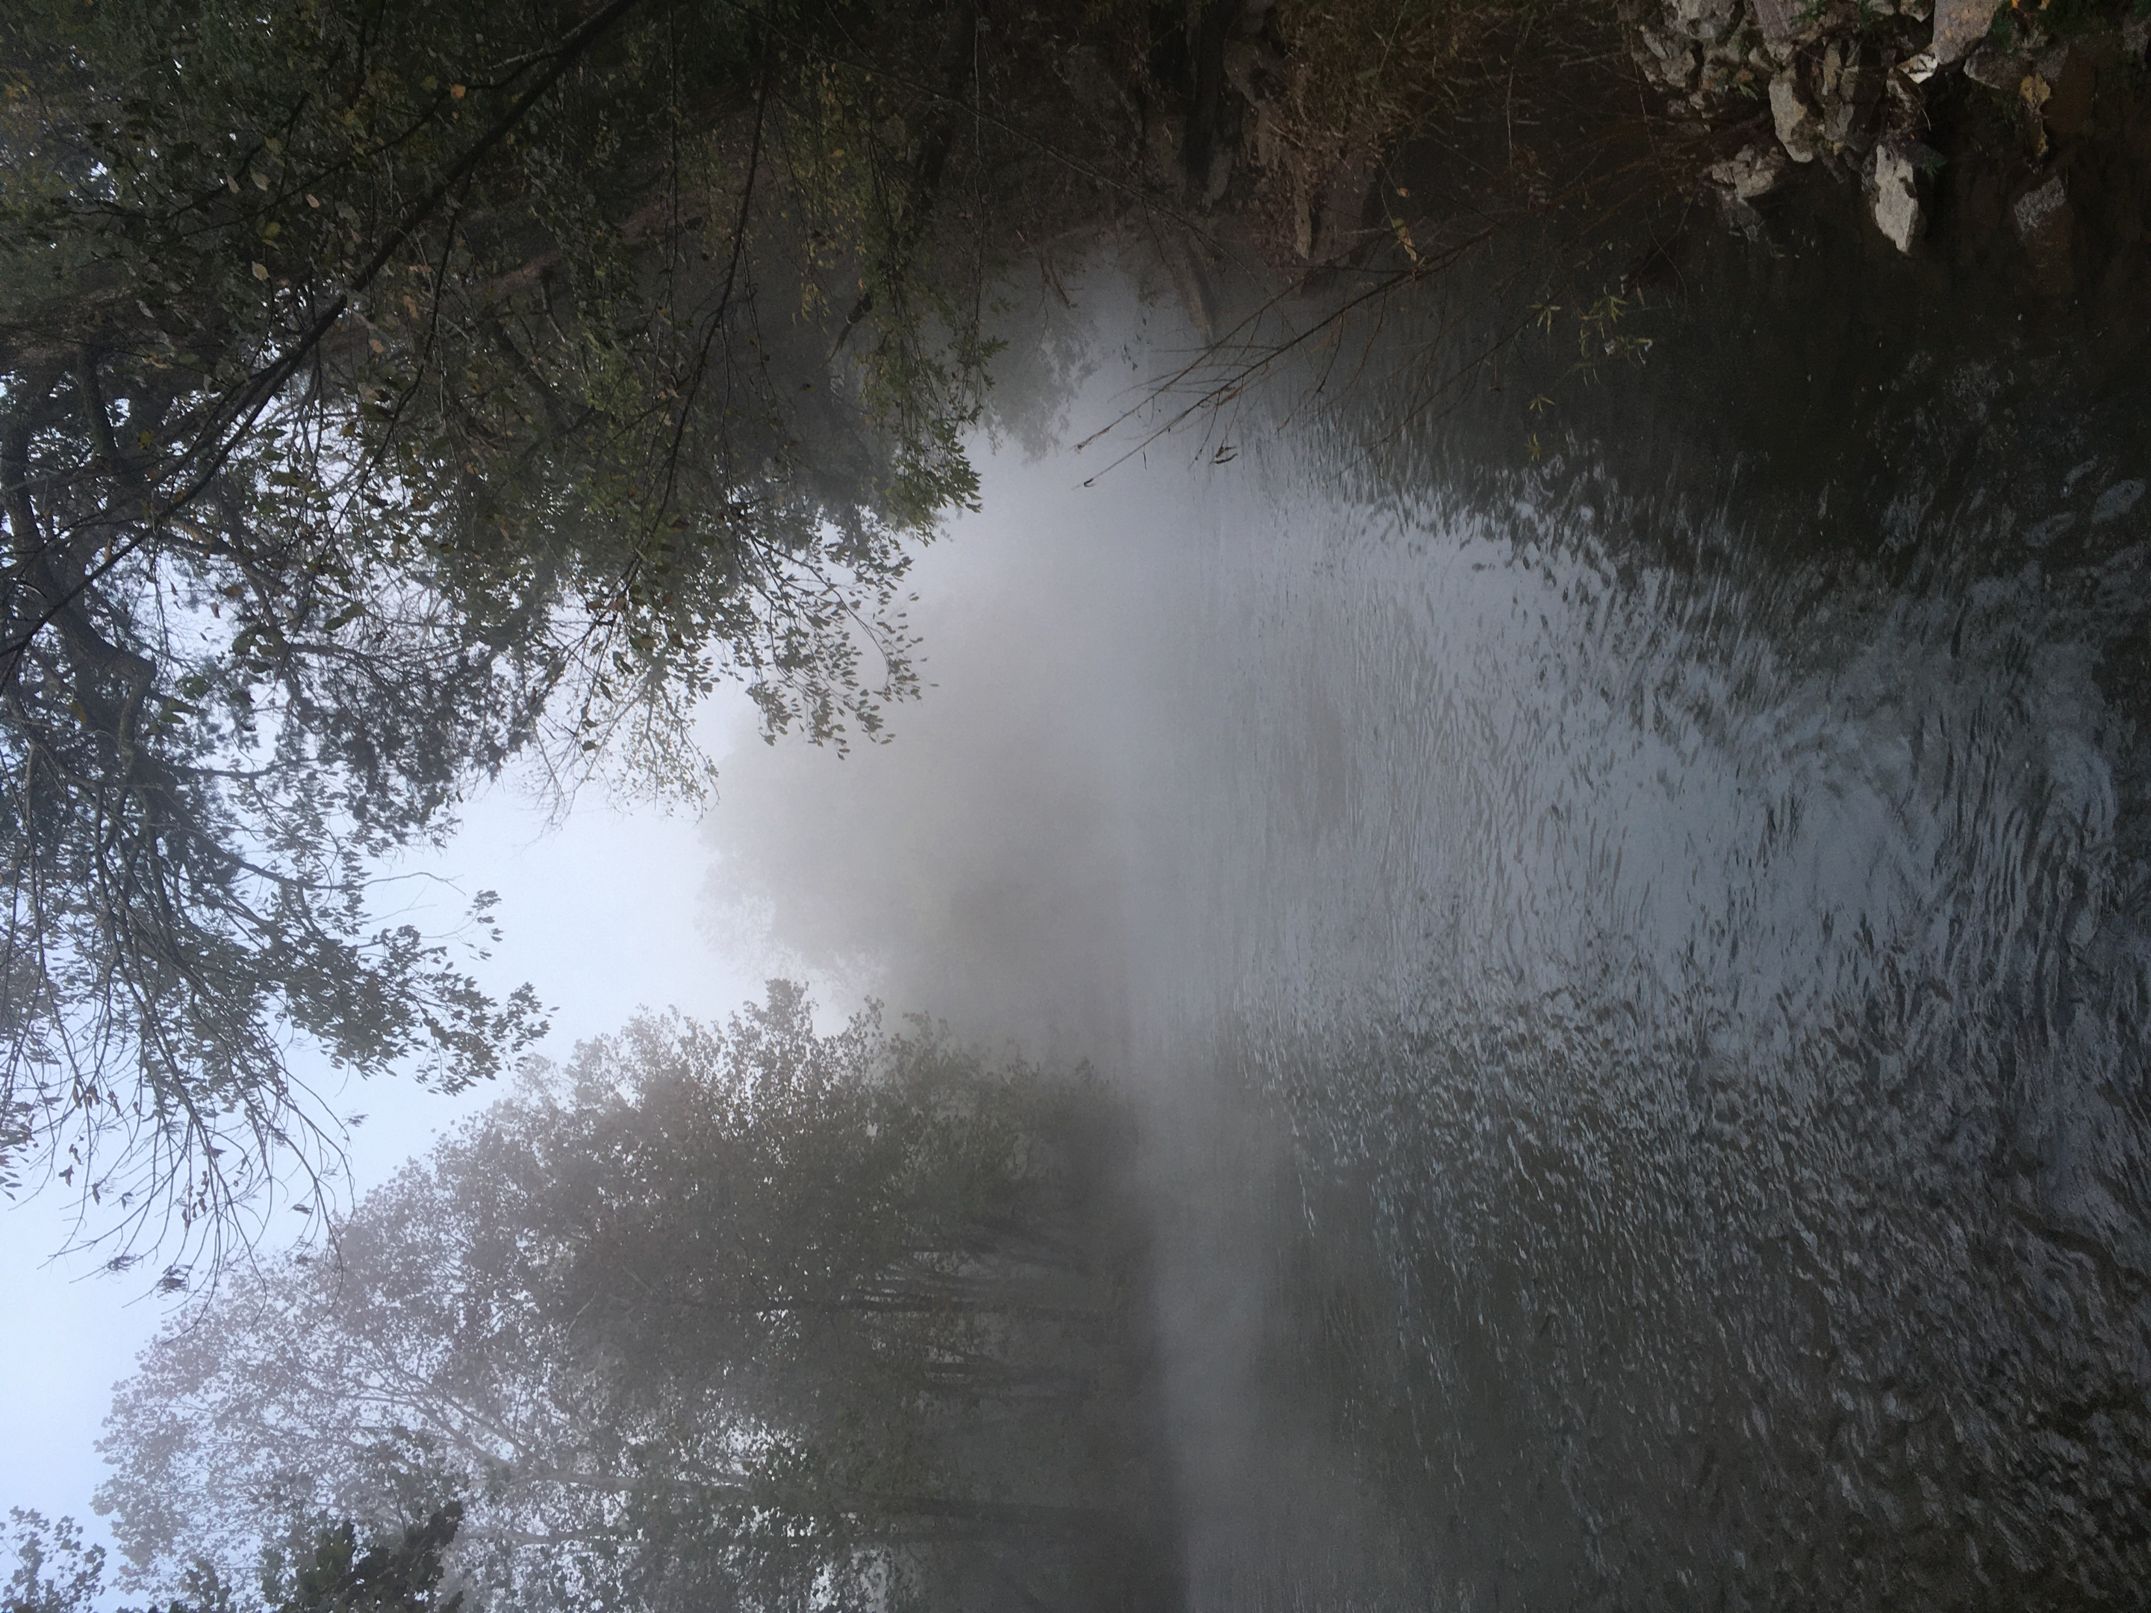
Categories
Type
Category
Global Rank
State Rank
Federal Status
Notes:
But we’ll get further into that, I don’t want us to get ahead of ourselves too quickly. So what kind of spread are we talking about when we look at biodiversity in species data? What categories does the data give us that we’re going to explore? Species have a type and category. This data also has three classification systems: global rank – which is the global or world-wide rank of a species (this is a non-legal rank indicating the rarity and vulnerability of a species)., next is the state rank – which is much like the global rank but indicates the rarity and vulnerability of a species at the state level, and finally the federal status – which is the federal listing under the US Endangered Species Act. For this analysis we’ll explore each of the three rankings, however we’re going to dive the deepest on the global ranking as it puts Tennessee on a comparative scale rather than an internal one, and as this is a scientific community driven ranking rather than a federal funding driven ranking. I’ve also decided to only use rankings that indicate that the status of the species is determined, rather than those that indicate the need for further review.
On a technical note, this data all came as lists of strings within the separate categories (global rank, state, etc., so in order to generate these choropleth maps you’re seeing these were all converted to binary datatypes.

Slide 7
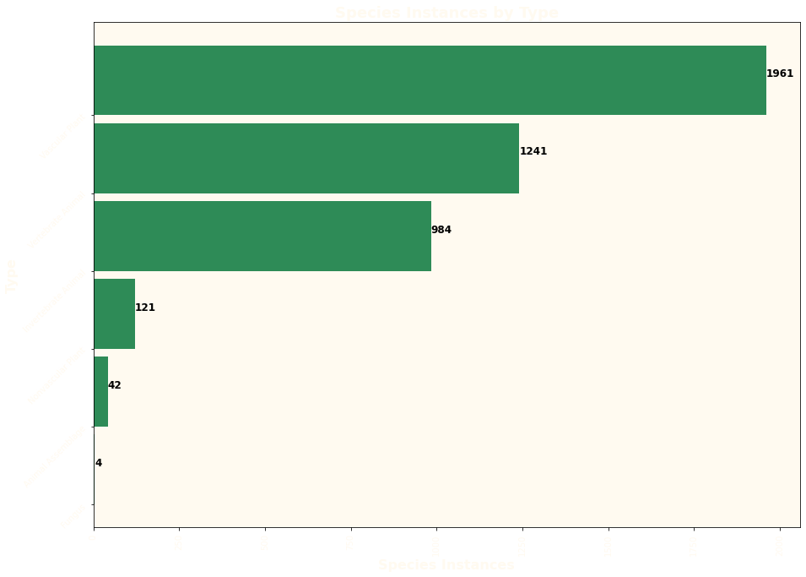
Notes:
Now we have a series of bar graphs showing the breakout of the entire dataset. Beginning with species type:
Vascular plants are a huge group of plants that are defined as land plants with tissues that conduct water and minerals throughout the plant.
Vertebrate animals are animals with backbones – to put it simply
Invertebrate animals are cold blooded animals with no backbone – we see a lot of mollusc observations in this data
Nonvascular plants include mosses, liverworts and algae – they don’t have the same methods as vascular plants for distributing water so are often limited in size and they don’t produce flowers, fruit or wood.
An animal assemblage is a group of fossils
Finally fungus is a group of spore-producing organisms feeding on organic matter – most prominently mushrooms
It is interesting to see there are only 4 fungus observations, this leads me to think that there may be some collection bias due perhaps to TDEC’s priorities so we do need to keep that in mind – this is an approach to looking at biodiversity in the context of this dataset.

Slide 8
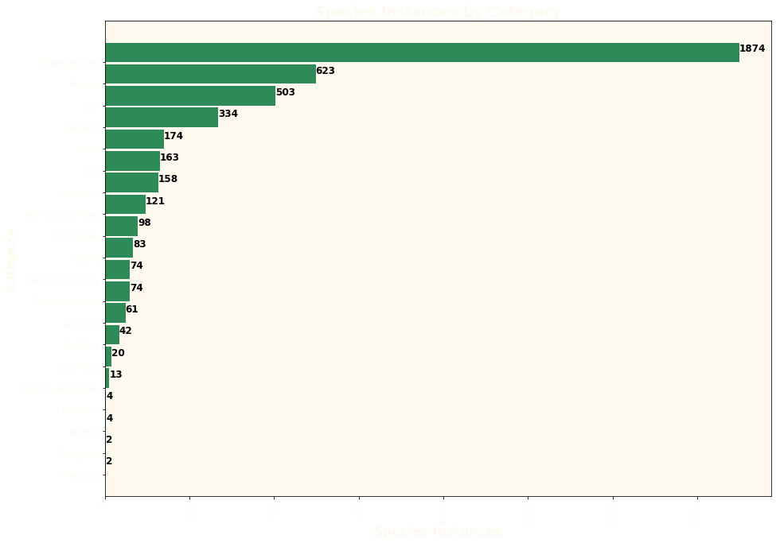
Notes:
Categories are a more granular than types and tell us what class the species are in. by far the most observations are of flowering plants, followed by molluscs

Slide 9
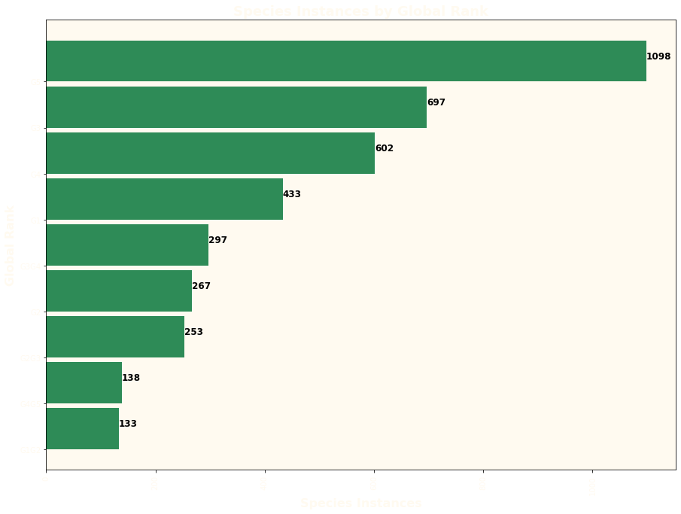
Notes:
Now we’ll look at global rank – G5 species are those that are demonstrably widespread and secure globally. G4 are widespread but with cause for long-term concern. G3 are rare and uncommon or found locally in a restricted range. G2 are extremely rare and imperiled within the world, six to twenty occurrences, or few remaining individuals, or because of some factor(s) making it vulnerable to extinction. G1 is extremely rare and critically imperiled in the world with five or fewer occurrences, or very few remaining individuals, or because of some special condition where the species is particularly vulnerable to extinction.

Slide 10
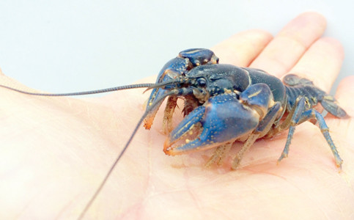
Globally Rare: Conasauga Blue Burrower
Notes:
This G1 crustacean is a rare crawdad – this lil guy is ranked S1 so is rare in the state as well, their habitat would typically be wet grassy areas and you can find most of them in the Conasauga watershed and parts of the Hiwassee river basin.

Slide 11
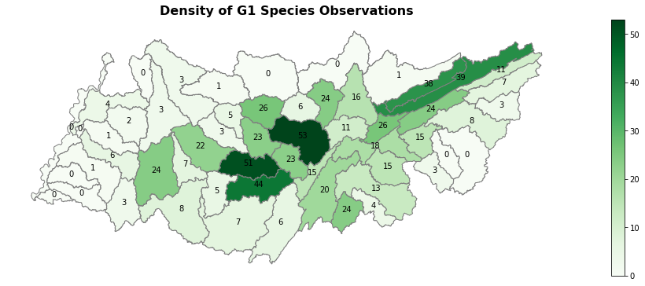
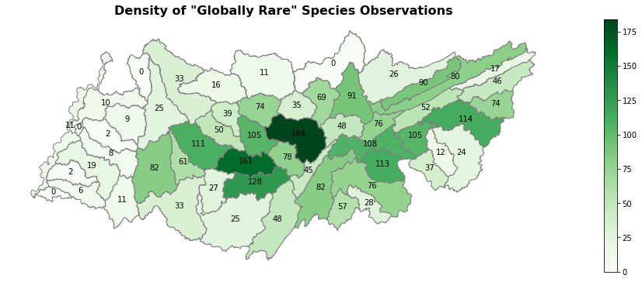
Notes:
“globally rare” is a combination of G1, G1G2, and G2 species. Along with the Caney Fork river, we’re also seeing hot spots in the Harpeth River, and the Upper and Lower Duck River watersheds.

Slide 12
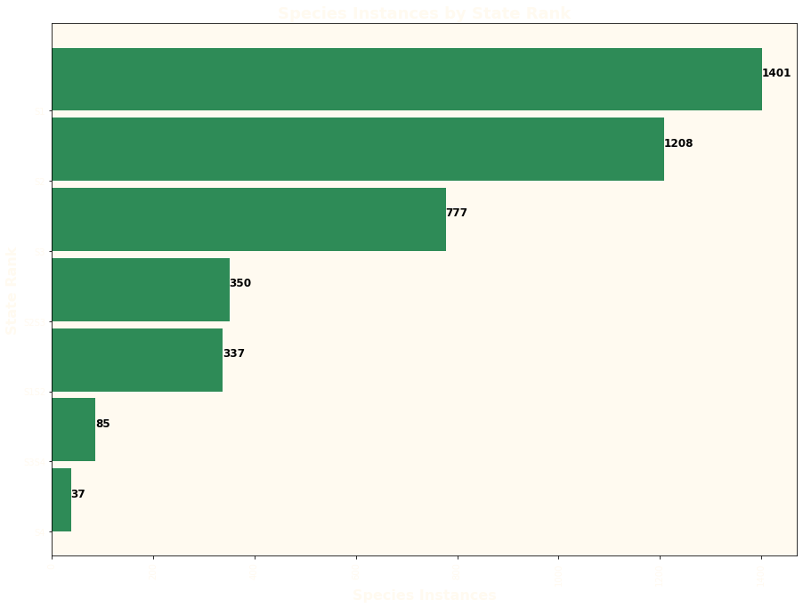
Notes:
It is notable that the most observations are of state rare species, while the most observations classified in the global system are of secure species. Obviously this is scaled differently but it is still interesting that in this scale more species would be considered “rare”, or perhaps the Department of Environment and Conservation – as a state institution – focuses data collection on state rare species.

Slide 13
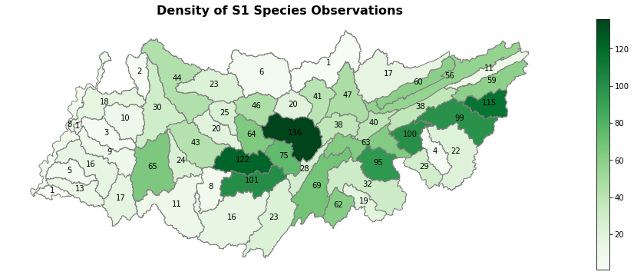
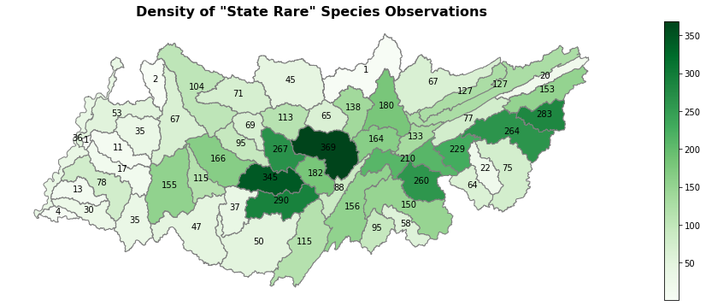
Notes:
Again, the state rare is a combination of S1, S2, and S1S2 categorized species. We see the state rare species concentrated mostly in the same areas as the globally rare species.

Slide 14
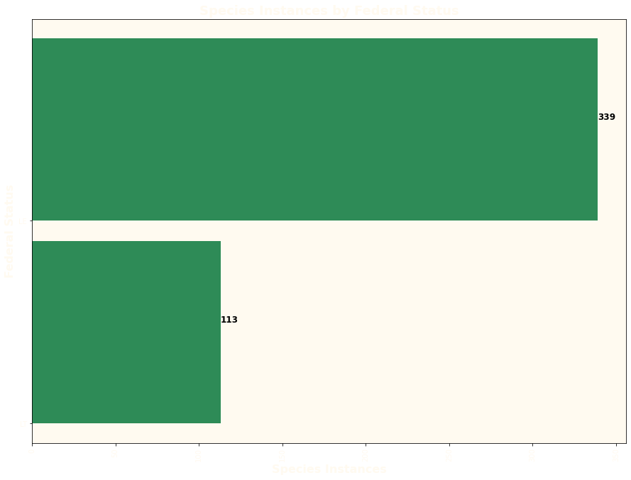
Notes:
Much less of the data received a federal tag than a global or state tag. Here we see 339 endangered species observations and 113 threatened species.

Slide 15
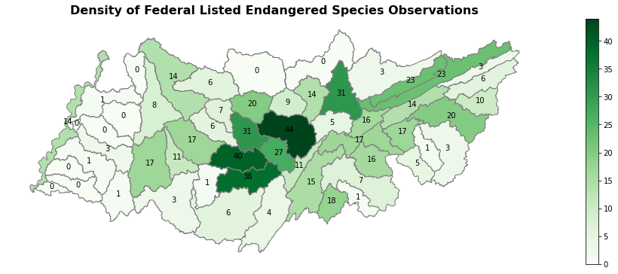
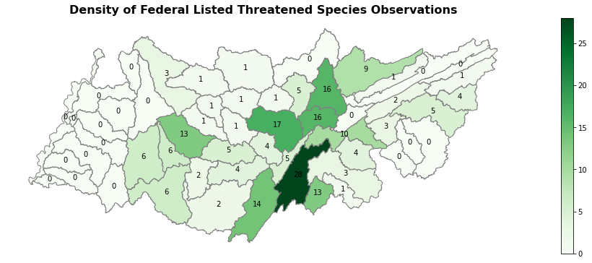
Notes:
The federally endangered species are also concentrated in the same areas as the other “rare” designations. However, we’re seeing the most threatened species observations in the Sequatchie river watershed.
Since we’re seeing the most rare species observations in the Caney Fork River watershed – we’re going to zoom on in.

Slide 16
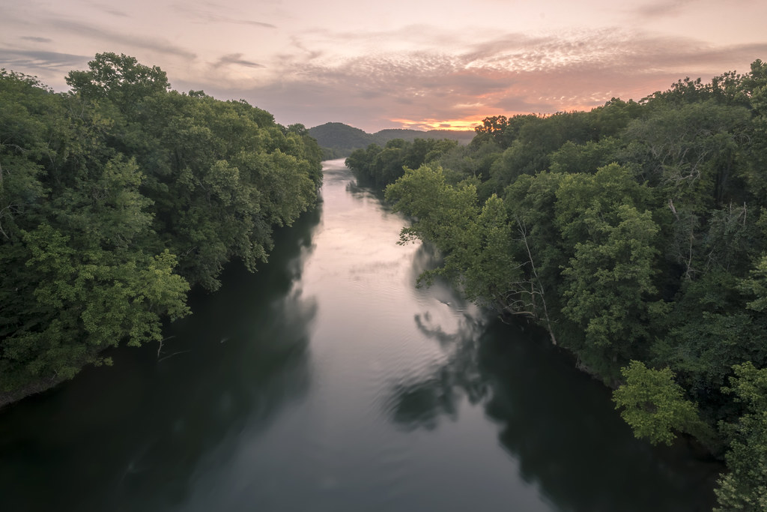
Caney Fork River Watershed
Notes:
Since we’re seeing the most rare species observations in the Caney Fork River watershed – we’re going to zoom on in.

Slide 17
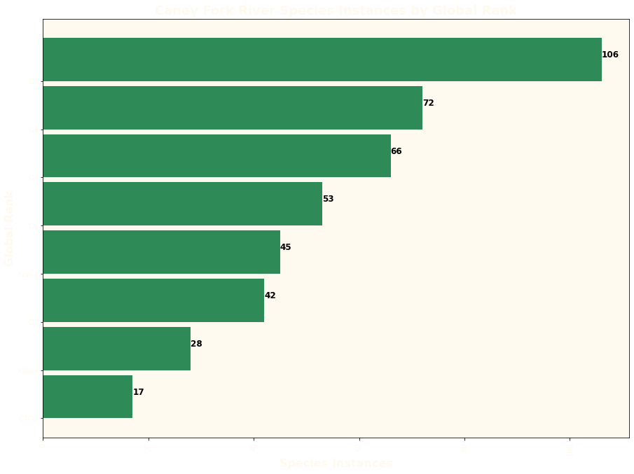
Notes:
So when we zoom into the Caney Fork River watershed we’re looking at 466 species observations representing 185 unique species. As you can see above 53 of these total observations are of G1 globally rare species. This is actually 29 unique species.

Slide 18
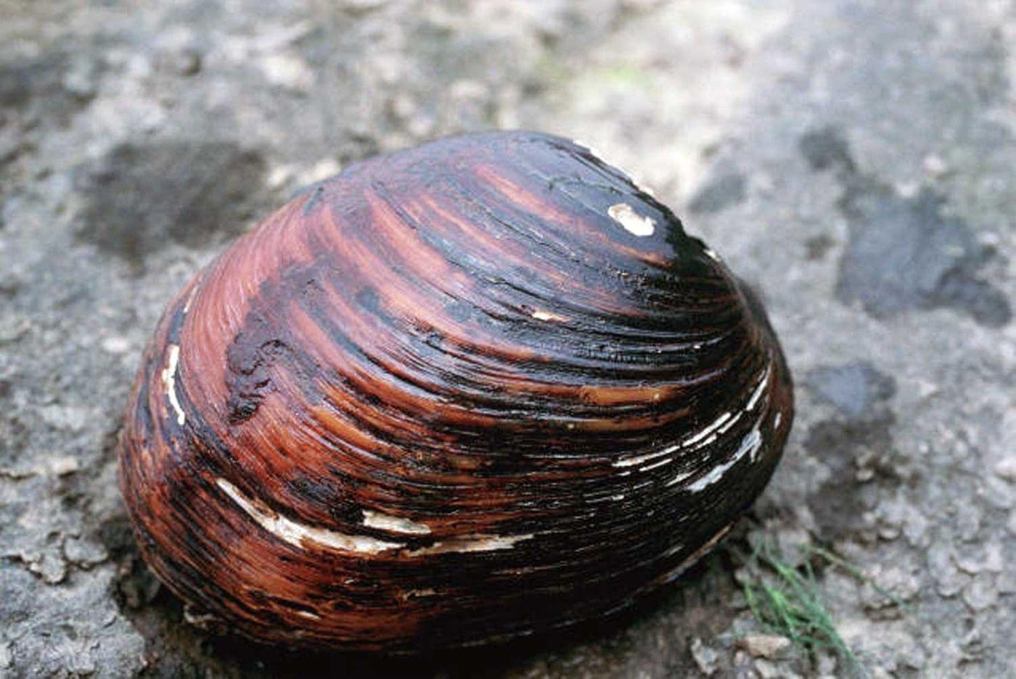
Globally Rare: the pink mucket
Notes:
This is a mollusc; an invertebrate animal, that is listed as G1G2 also as a federally listed endangered species. The habitat is listed as: Generally a large river species, preferring sand-gravel or rocky substrates with mod-strong currents; Tennessee & Cumberland river systems. There is only one listed observation. There are a few other listed molluscs: the Snuffbox, the Spectaclecase, the Sheepnose, the Slabside Pearlymussel, and the littlewing pearlymussel… most observations of federally endangered species in the Caney Fork River watershed seem to be molluscs.

Slide 19
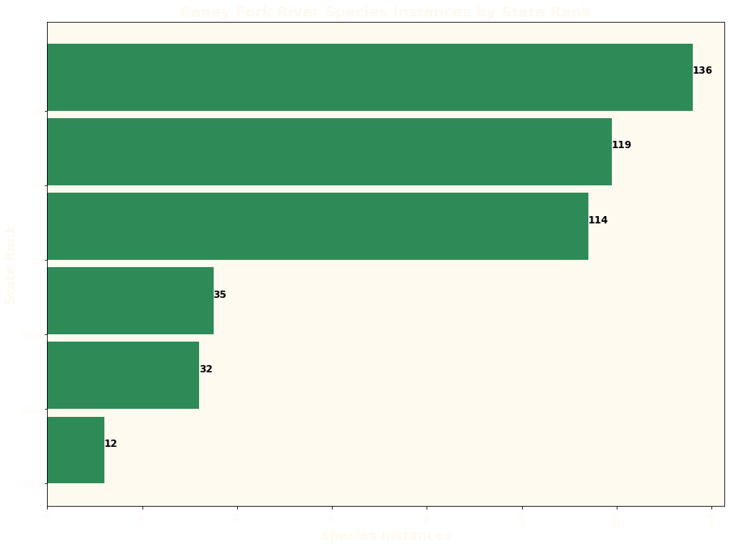
Notes:
Where we see 136 S1 observations here it represents 81 unique species.

Slide 20
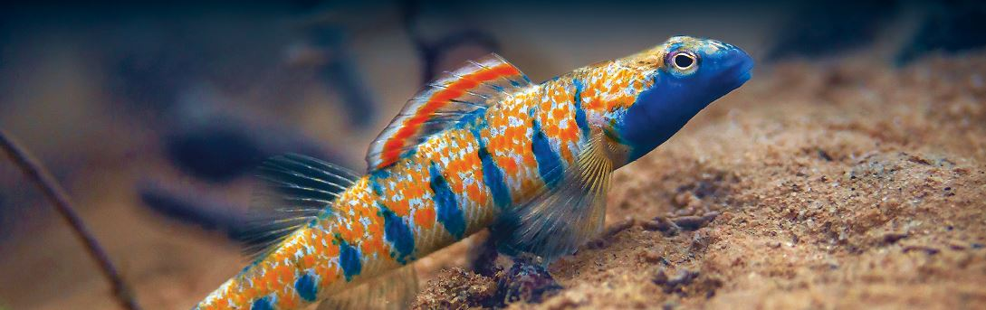
State Rare: the Bluemask Darter
Notes:
This is a fish; a vertebrate animal, that is an S1 and federally listed as an endangered species. The habitat is listed as: Streams with slow to moderate current over clean sand and fine gravel; Caney Fork River system (above Great Falls Reservoir). Here are four listed observations.

Slide 21
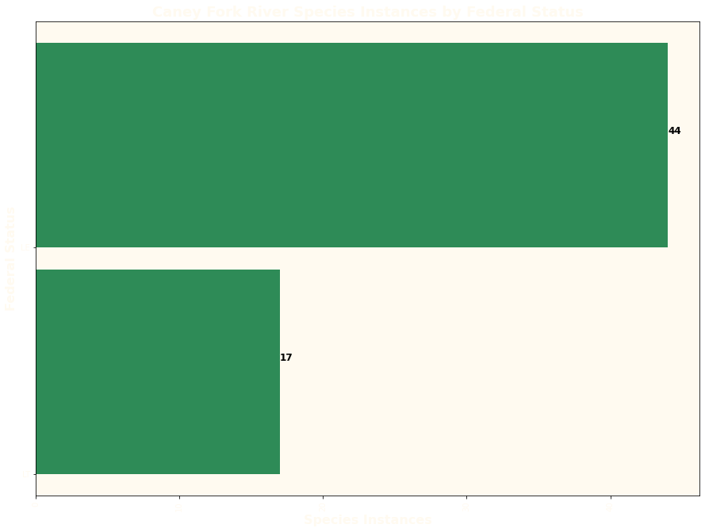
Notes:
There are 44 observations of federally endangered species here representing 13 unique species.

Slide 22
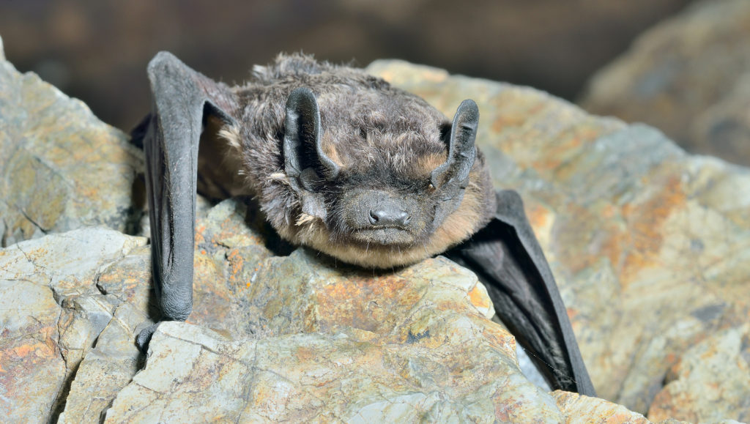
Listed endangered: the Gray Myotis
Notes:
This is a mammal; a vertebrate animal, that is federally listed as an endangered species. The habitat is listed as: cave obligate year-round, frequents forested areas – migratory. There have been 16 observation

Slide 23
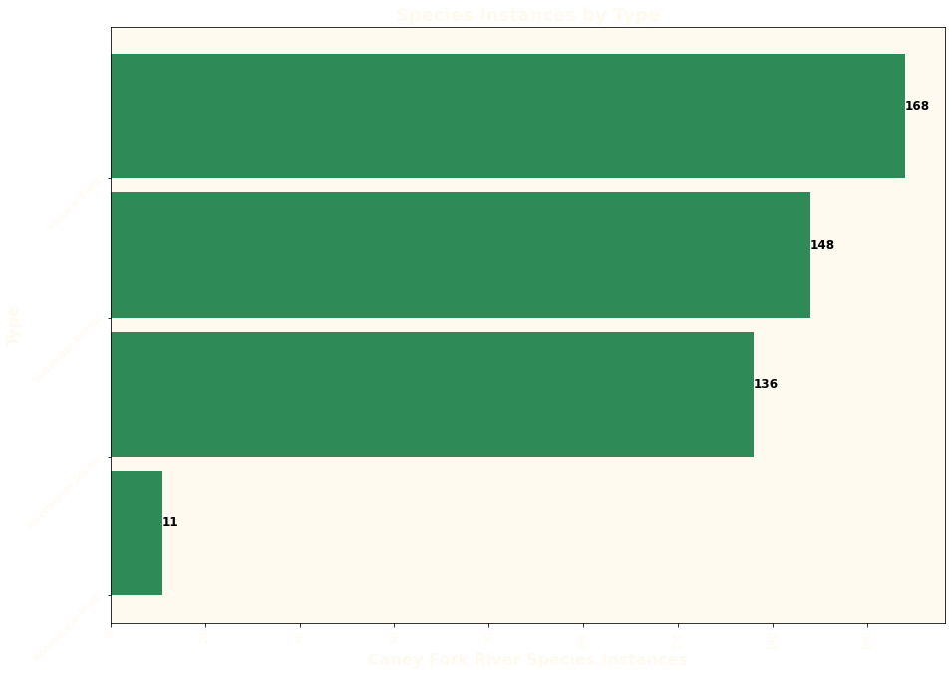
Notes:
We’re mostly seeing vascular plants and vertebrate animals.

Slide 24
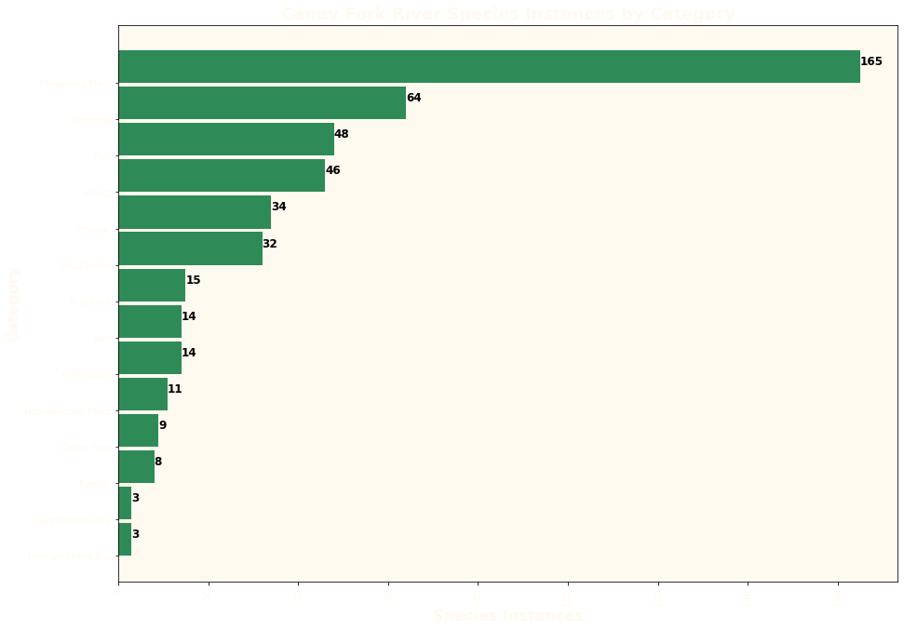
Notes:
Mirroring what we see when looking at the whole state – we’ve got mostly flowering plants when we drill down to category.

Slide 25
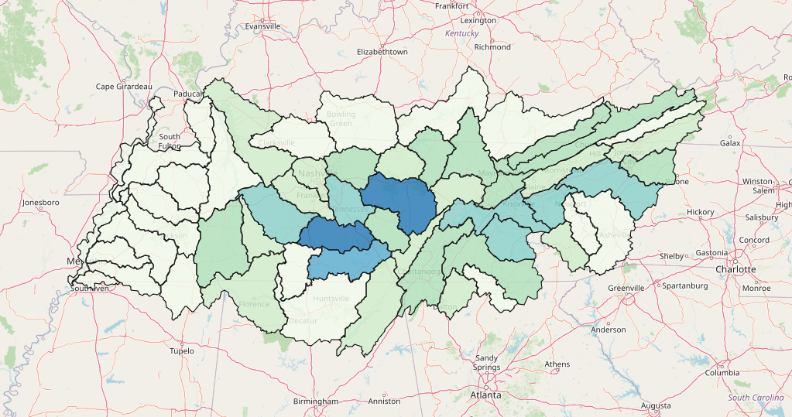
Notes:
So while you would be perusing this map I would again state the scope of biodiversity that we’re able to glean from this data: here is a breakout of 115,612 species observations representing 928 unique species. The most observations are of vascular, flowering plants. The watershed with the most biodiversity is the Caney Fork River area, representing primarily DeKalb, White, and Van Buren counties. The State of Tennessee has:
1,098 G1 species observations representing 131 unique species
1,401 S1 species observations representing 465 unique species
339 federally endangered species observations representing 57 unique species
When we zoom in on the Caney Fork River – determined by our metrics to be the most biodiverse county as represented by this data, we see that there are:
53 G1 species observations representing 29 unique species
136 S1 observations representing 81 unique species
And 44 federally endangered observations representing 13 unique species

